Slide 1
MIXED REALITY
Current technologies
Prof. Mariolino De Cecco, ing Paolo Tomasin
Email: mariolino.dececco@unitn.it , paolo.tomasin@unitn.it
Laboratory website: http://www.miro.ing.unitn.it/

Slide 2
Reality-Virtuality Tecnologies

Slide 3
Reality-Virtuality Tecnologies

Slide 4
Reality-Virtuality Tecnologies

Slide 5
Reality-Virtuality Tecnologies

Slide 6
Reality-Virtuality Tecnologies
VR Headset
Cardboard
VR Headset
Camera view
Leap motion
MR Headset
Haptic sensor
AR ToolKit
AR kit
Hololens
Projectors
Finally, the human

Slide 7
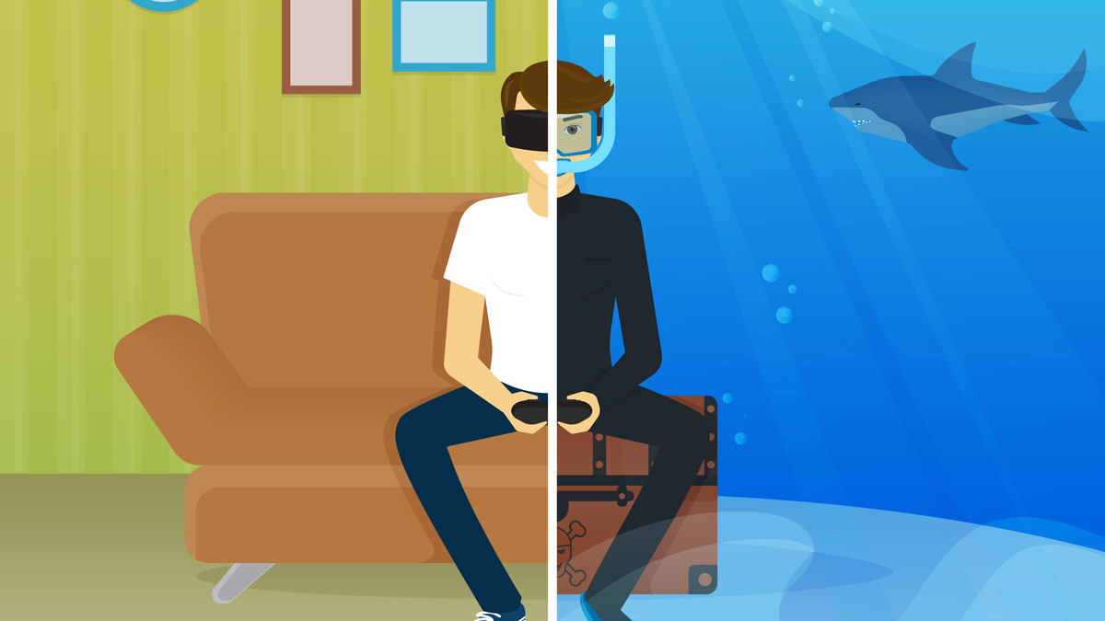
VR Tecnologies
Main Devices:
Daydream
Htc Vive
Oculus
Aims:
Interactive - The user’s input controls the system and guides the behaviour of the VR experience, while also modifying the virtual environment.
Immersive - An experience that provide a sense of presence as well as a sense of engagement.
Synthetic - The environment is artificial, created by a computer in real-time.

Slide 8
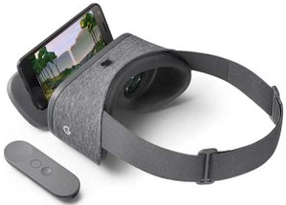
Specs:
Smartphone Display: 1920x1080
Refresh rate: 60 Hz
Field of view: 90 degrees
Sensor: Accelerometer, gyroscope, magnetometer (IMU)
Require an High Level Smartphone
Uses:
Immersive in virtual 3D environments
Watch 3D videos
Interaction with 1 joystick
Daydream (Smartphone based) CardBoard

Slide 9
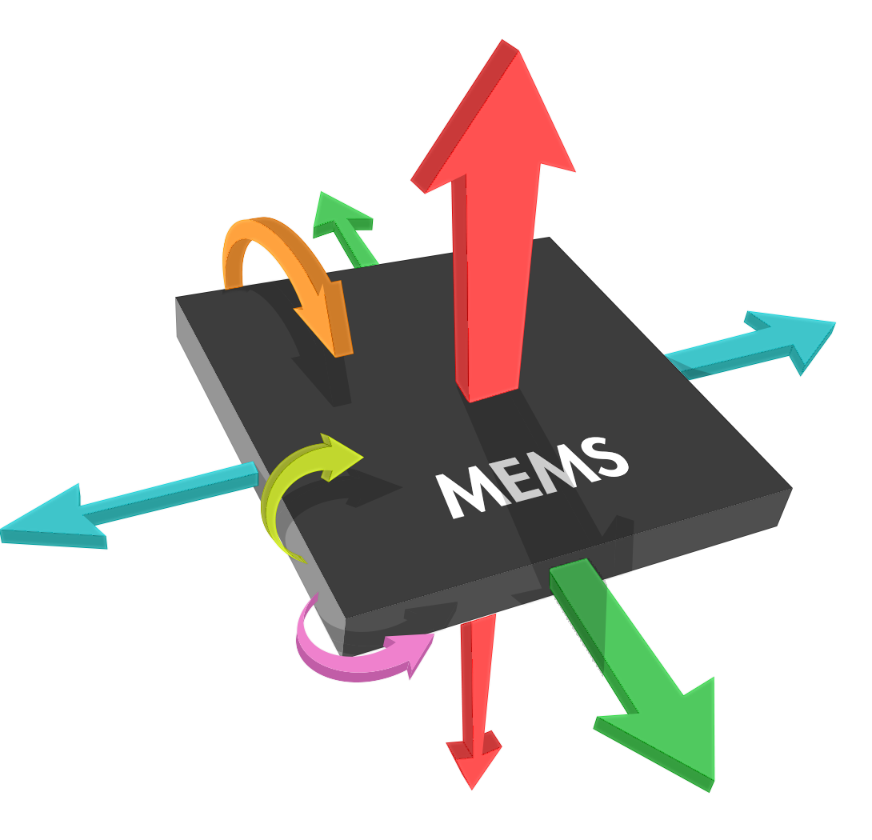
Inertial Tracking is made possible by the use of accelerometers and gyroscopes integrated in the smartphone:
Accelerometers measure linear acceleration, which is used to calculate velocity and the position of the object relative to an initial point.
Gyroscopes measures angular velocity. It is a solid-state component based on microelectromechanical systems (MEMS) technology and operates based on the same principles as a mechanical gyro.
PRO: inexpensive technology can provide high update rates as well as low latency
CON: the calculations (i.e. integration and double-integration) of the values given by the accelerometers (acceleration) and gyroscope (angular velocity) result in a significant drift in position and attitude information
Positioning using IMU data

Slide 10
An inertial measurement unit (IMU) is an electronic device that measures and reports a body's specific force, angular rate, and the magnetic field surrounding the body, using a combination of accelerometers, gyroscopes and magnetometers.
How to find position from acceleration?
$$v=u+a∗t$$
$$S=u∗t+ \frac{1}{2}at^{2}$$
So it’s possible to measure the position of an object with accelerometer, but…
[youtube] short-term position tracking
Positioning using IMU data

Slide 11
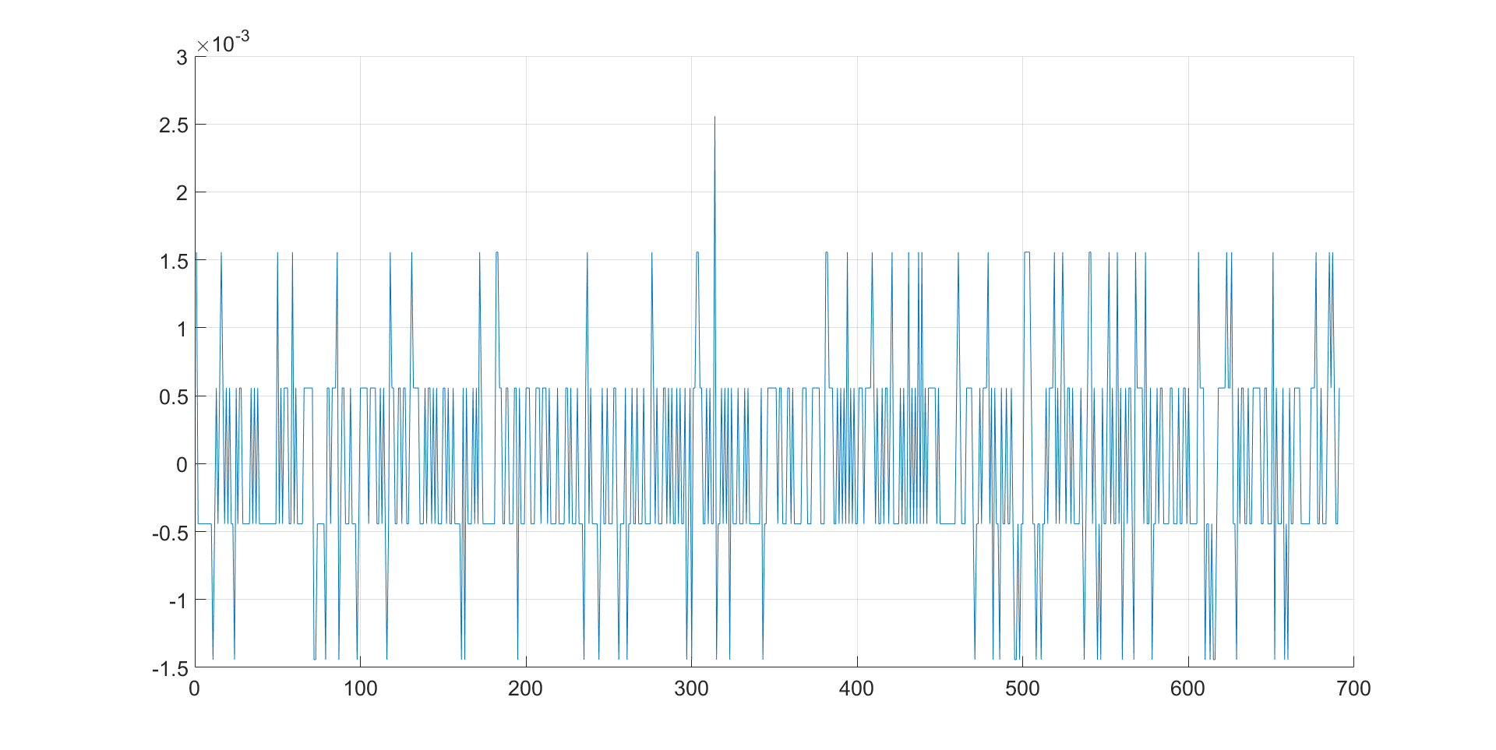
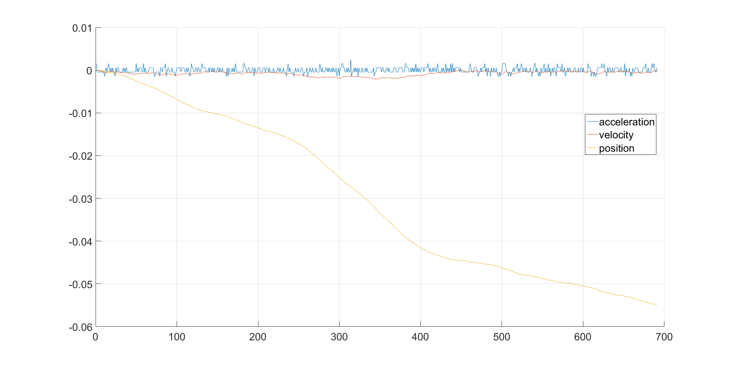
To result in actual position values, linear acceleration (i.e. data from an accelerometer minus gravity) needs to be integrated twice. If there is only a minimal bias on the data of one of the tracked axes, the resulting position values will rapidly drift off.
A minimal error in reading the acceleration…
Will lead to an enormous error in the estimation of position!
The «Drift» problem

Slide 12
If the main goal is to watch 3D videos, it can be ok…
https://www.youtube.com/watch?v=t6AgjM3P1q4
https://www.youtube.com/watch?v=LpQYs54IY5Q
But, if we need an immersive sensation inside a 3D environment, we must have something more robust
Carboard usecases

Slide 13
Specs:
OLED Display: 2160x1200
Refresh rate: 90 Hz
Field of view: 110 degrees
Tracking area: 5x5 feet
Sensor: Accelerometer, gyroscope, magnetometer, Constellation tracking camera
High Level PC
Uses:
Immersive in virtual 3D environments
Possibility to move inside virtual environment with physical movements
Virtual interaction with 2 joystick
Facebook Oculus Rift

Slide 14
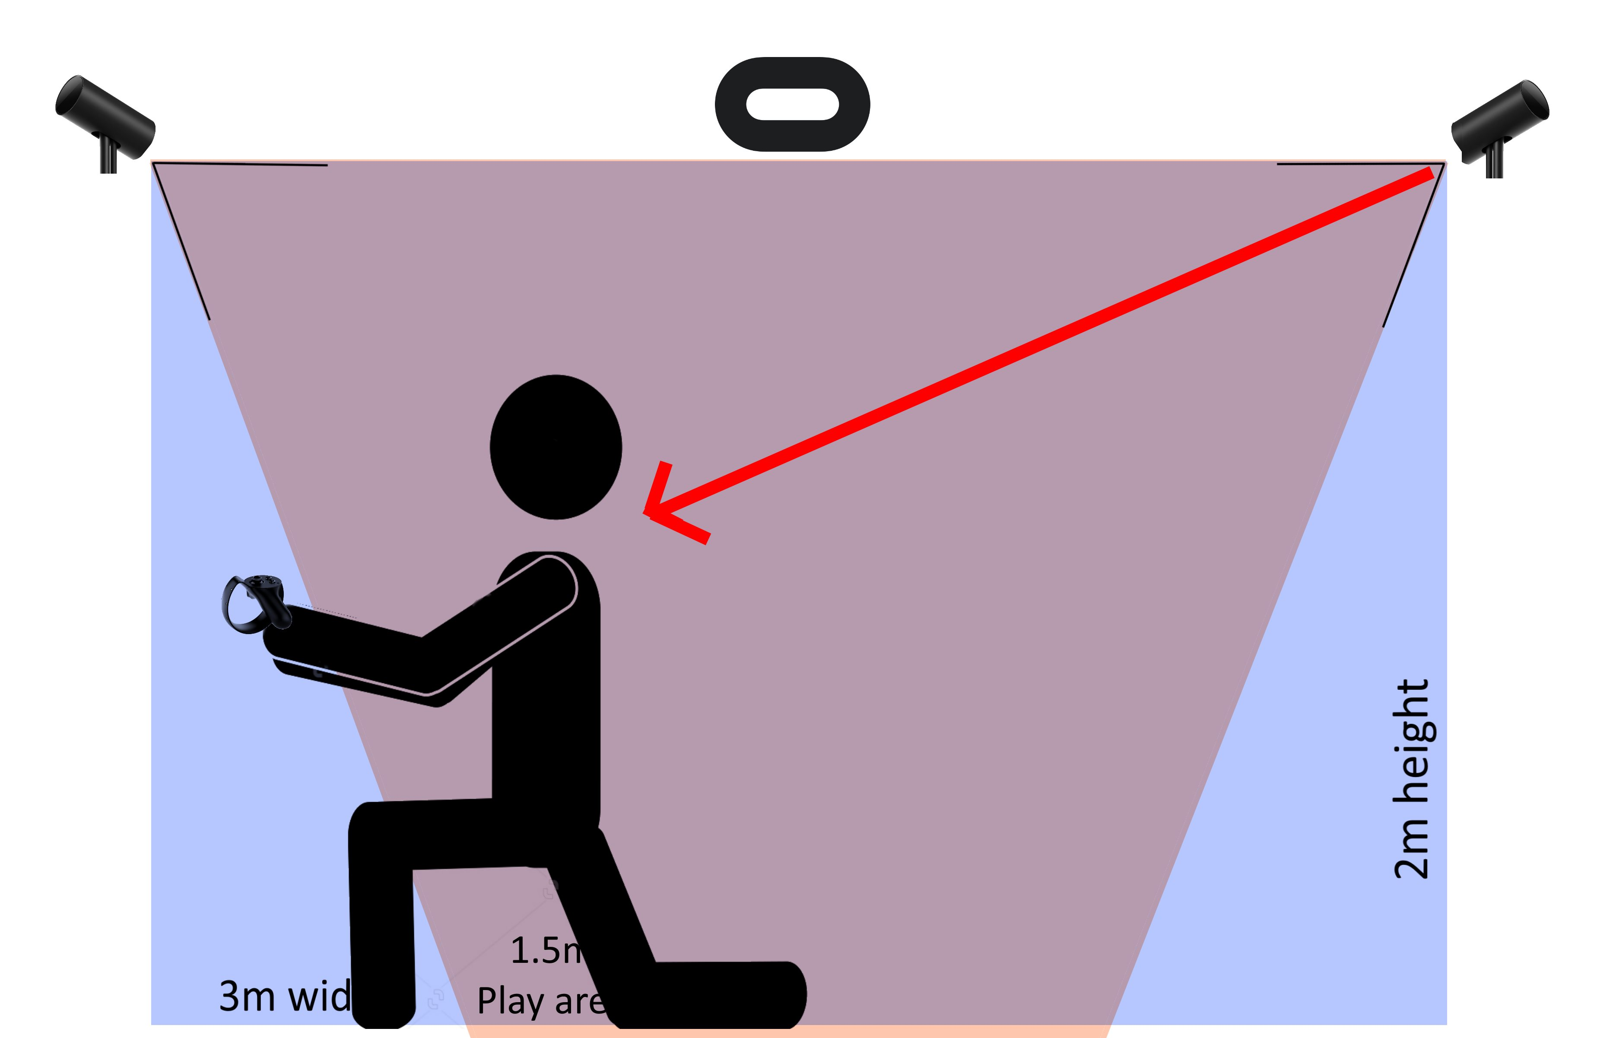
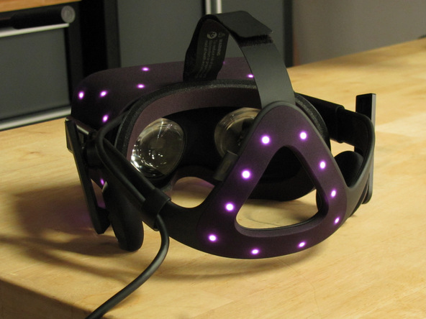
The “Constellation Low Latency Tracking System” consists of a Base Station with a receiver equipped with infrared sensors that senses the signals from the infrared LEDs contained in the Rift Headset. These IR LEDs transmit their light in a specific pattern so that the Base Station is capable to recognize each LED individually and thus the 3D pattern on which they are located and, finally, position and attitude in 6 degrees of freedom…. Just like a 2D marker (that must be seen from the front, in this case not!)
The system updates the HMD pose at 60 Hz (16.7 ms) with a minimum repeatability error (more or less 0.005 m).
Constellation tracking camera

Slide 15
Oculus Rift for HMD pose estimation uses:
the IMUs as the primary positional tracking system. It responds extremely quickly and updates at several hundred Hz (1000Hz sampling, 500Hz reporting). However, IMUs drift on the order of meters per second
Constellation are used to reduce IMU’s drift 60 times per second using their optical sensors to provide an absolute position reference
NOTE: commercial optical MoCAP systems do not generally use active markers (though some do), but retroreflective markers and an illumination system adjacent to the camera lens. These relative dim markers are still easily discriminable in all but the harshest (e.g. outdoors in direct sunlight) conditions.
Sensor Fusion between the Constellation and IMUs

Slide 16
Constellation main advantage is the high accuracy in the estimation, but still a very big problem: the frame rate. It‘s not possible to update the head position more than 60 times/s, i.e. every 16 ms. This would lead to motion sickness in less then 5 seconds!
So the strategy used at Facebook was to implement the two things (IMU and Camera) and “fuse” the estimations.
IMU estimation:
++ high frame rate (1000 Hz)
- - drift
Camera estimation:
++ high accuracy
- - low frame rate
Fused estimation:
++ high frame rate
++ high accuracy along time
Sensor Fusion between the Constellation and IMUs

Slide 17
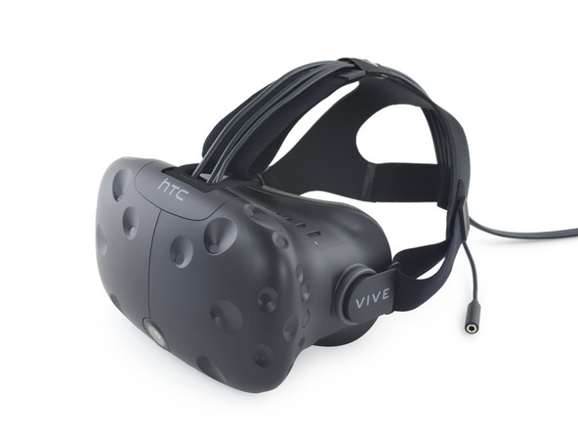
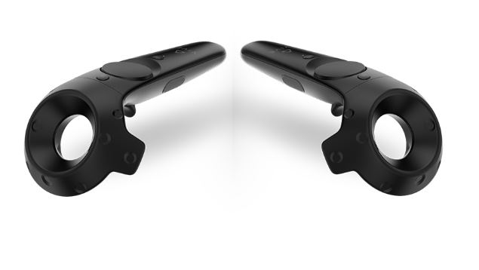
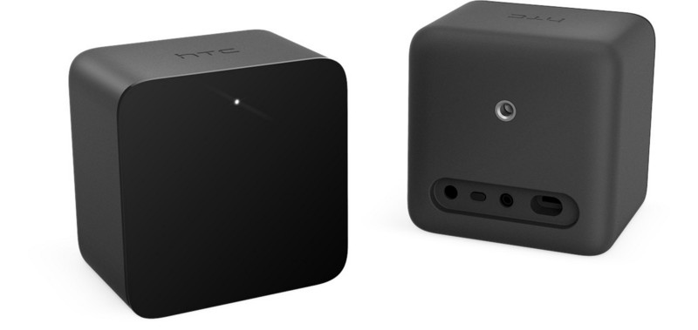
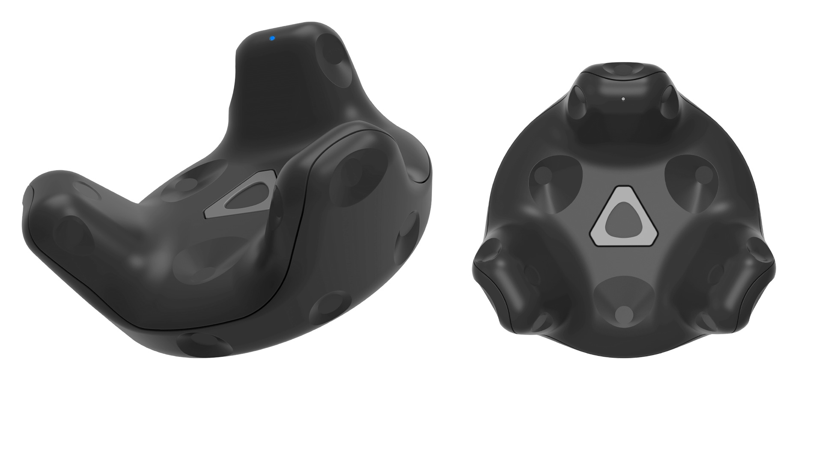
Specs:
OLED Display: 2160x1200
Refresh rate: 90 Hz
Field of view: 110 degrees
Tracking area: 100 m2
Sensor: Accelerometer, gyroscope, Lighthouse laser tracking
High Level PC
Uses:
Immersive in virtual 3D environments
Possibility to move inside virtual environment with physical movements
Virtual interaction with 2 joystick and other trackers
HTC Vive

Slide 18
Central to the Lighthouse technology are the Base Stations (small rectangular objects placed in the tracking area). They serve as reference for any tracked devices such as the HMDs and controllers, and trackers.
Base Stations perform this function by constantly flooding the room with a non-visible light. The receptors on the tracked devices would intercept the light and figure out where they are in relation to the Base Stations.
Each Base Station contains:
an IR beacon called Sync Blinker that emit a synchronization pulse
2 laser emitters that spin 60 times per second,
The receptors (HMDs, controllers and trackers), are covered with photo sensors that recognizes the synchronization pulse and the laser beams.
When it detects a synchronization pulse, the receptor starts to count until one of its photo sensors is hit by the laser beam. Lighthouse calculates When the photo sensor is hit by the laser and knowing Where that photo sensor is located is able to find the exact position of the receptor in relation to the Base Station.
Lighthouse laser tracking system

Slide 19
How Lighthouse works: https://www.youtube.com/watch?v=J54dotTt7k0
Base Stations serve as reference for any tracked devices such as the HMDs and controllers, and trackers.
HMD
Controllers
Trackers
Base Stations are vulnerable to occlusion. They require line of sight to the tracked objects. For this they are designed to be scalable: 2 of them can be placed in opposite sides of a room to minimize this problem, furthermore more Base Stations can be placed to increase the tracking range.
Lighthouse laser tracking system

Slide 20
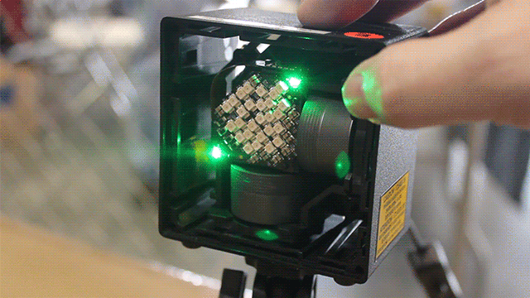
Lighthouse is used also as a general purpose indoor position tracking system also for robotic applications
A tracker can be placed onboard mobile robots, drones or human body allowing them to be accurately tracked in 6DOF
Lighthouse laser tracking system

Slide 23
Google Earth
https://www.youtube.com/watch?v=SCrkZOx5Q1M
HTC Vive usecases

Slide 24
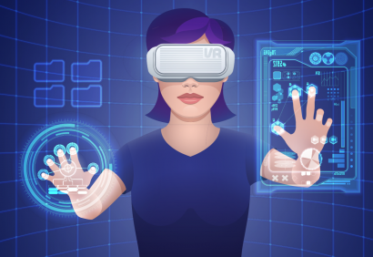
AV Tecnologies
Aims:
Putting real information into the virtual environment we achieve:
Improve Interactivity – The user’s input controls the system and guides the behaviour of the VR experience using his/her hands or other real object.
More Immersive – The sense of engagement is more robust because we can recognize that there are real things in the virtual environment or even our body movements.
Less Synthetic – The environment is artificial, created by a computer in real-time but using information from the reality such as weather data, webcams view or environmental sensor information
Devices:
Cameras (2D or 3D)
leap motion
haptic sensor
ambient sensor

Slide 25
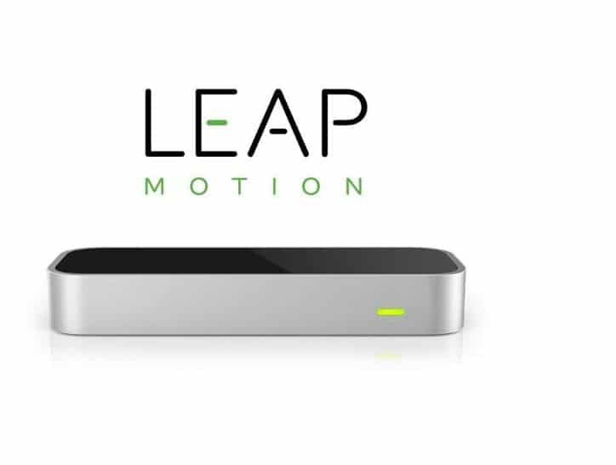
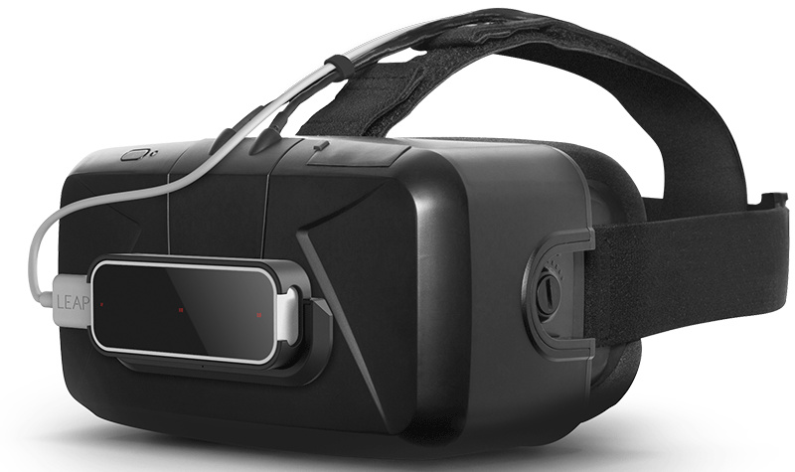
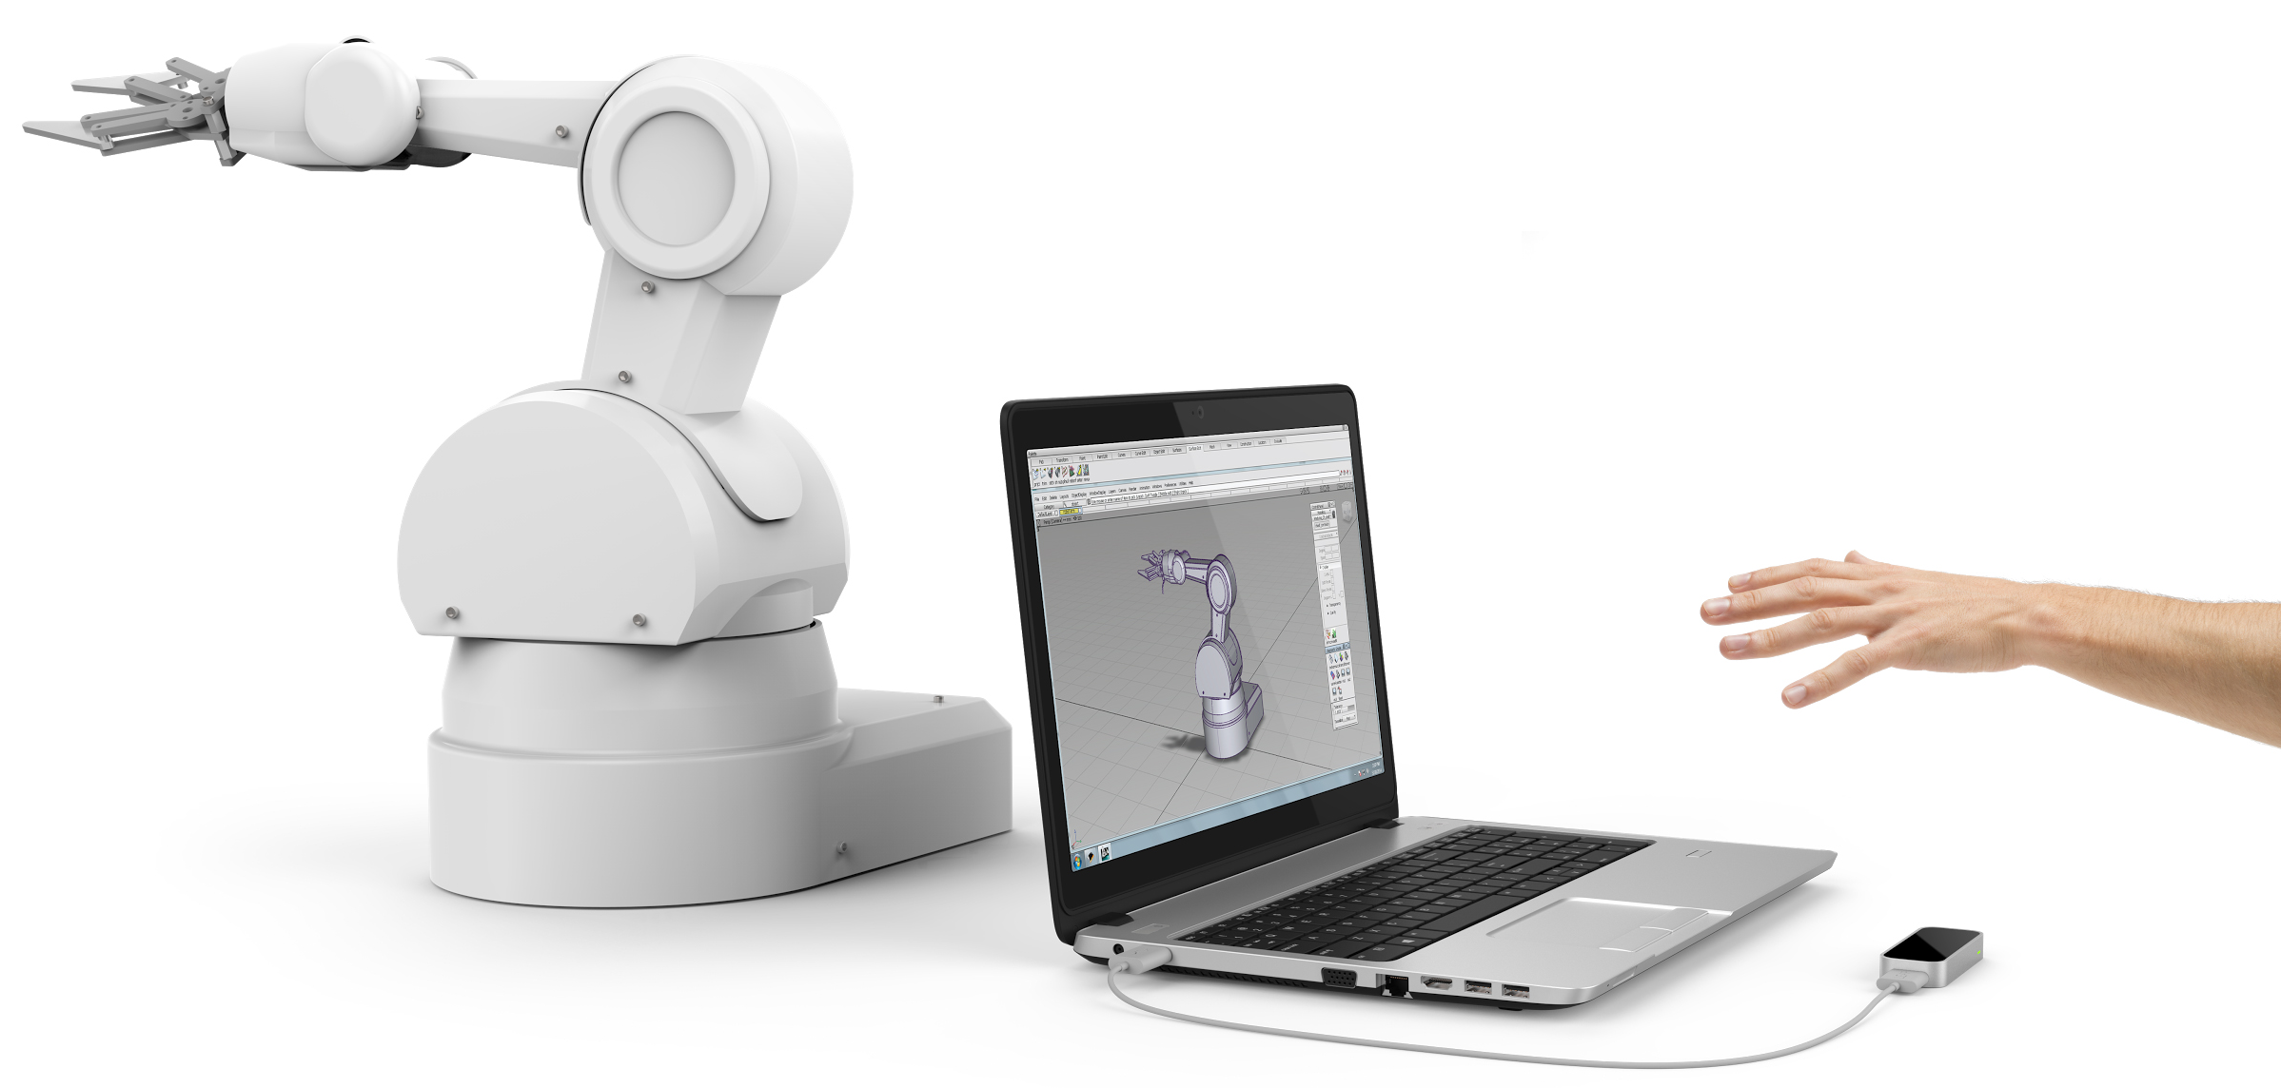
Leap Motion is a gesture sensing controller that allows the user to interact with various devices with hand movements. The devices captures your hand's motion from the perspective of the headset, allowing you to interact with the immersive VR environment without physical interactions.
Leap Motion can feed MR when attached to a head-mounted display HMD.
Compatible with Oculus Rift, Leap Motion VR is mounted to the front of the HMD.
Leap motion

Slide 26
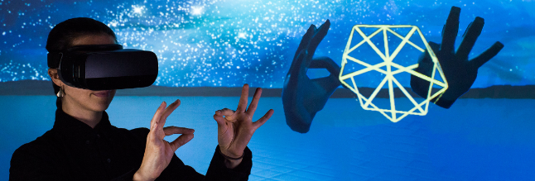
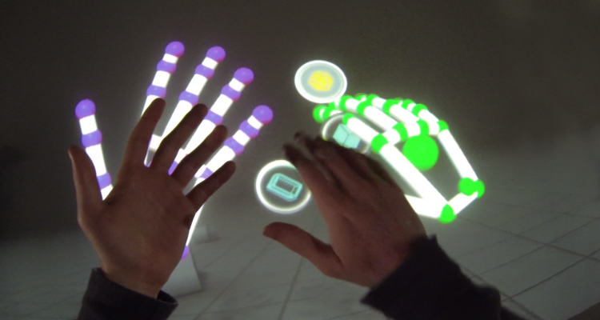
Leap motion example

Slide 27
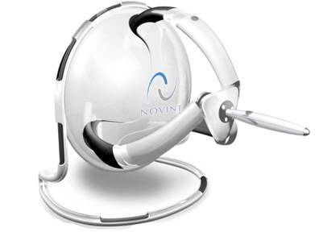
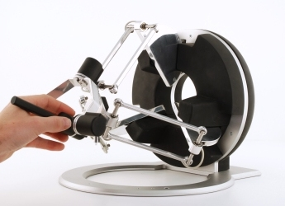
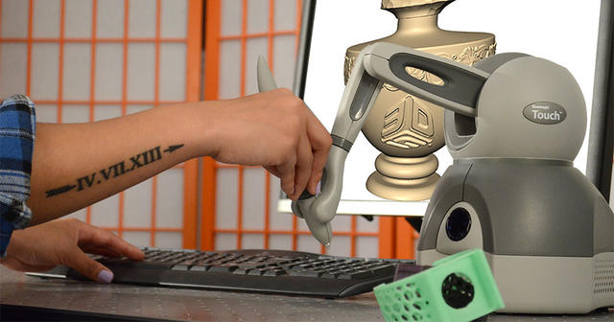
Haptics or Tactile feedback is a technology that produces the sense of touch through physical stimulation.
Haptics can improve the user's immersion in a VR world: it allows users to experience physical sensations virtually caused by their interactions with virtual objects: “When a user picks up a cup in the virtual world, the user should feel the realistic sensations of a cup in his or her hand. Even though the cup is not present in the real world”
Haptic devices

Slide 28
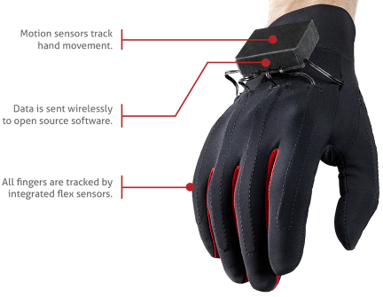
Haptic device example

Slide 29
Haptic feedback (vibrations) for every individual finger using actuators
Fully programmable amplitude
Simulate multiple frequencies at different levels
Unity integration plugin included
HTC Vive tracker
Haptic device example

Slide 30
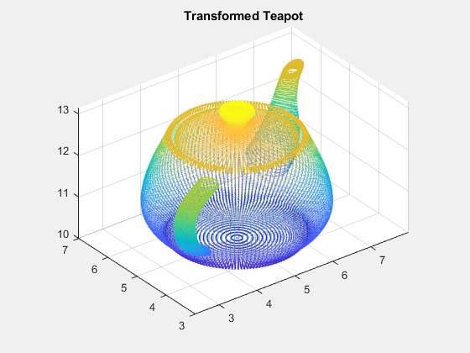
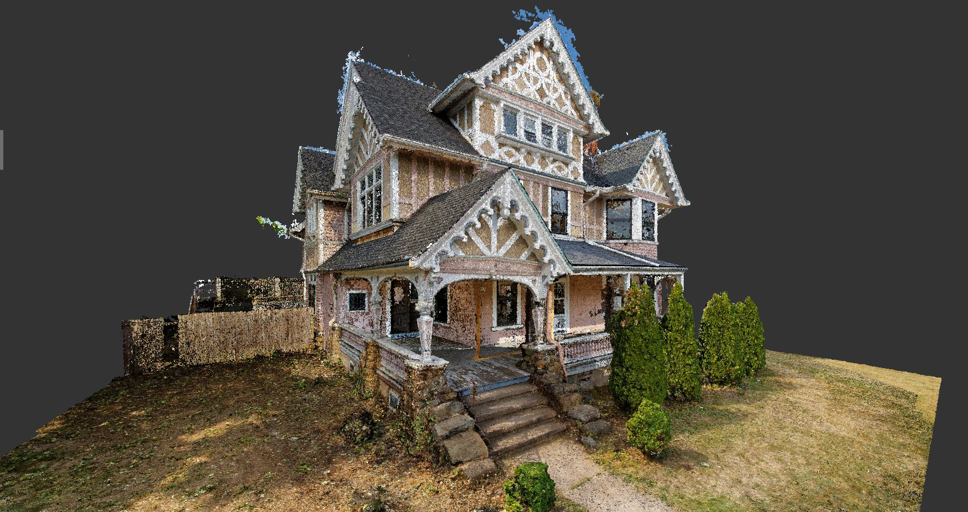
A point cloud is a set of data points related to a coordinate system.
In a 3D system, these points are usually defined by X, Y, and Z coordinates, and often are intended to represent the external surface of an object.
Point clouds may be created by 3D scanners, stereo systems, projection systems, monocular SLAM or TOF cameras. These devices measure a large number of points on an object's surface, and often output a point cloud as a data file
Point clouds are used for many purposes, including to create 3D CAD models for manufactured parts, metrology/quality inspection, and a multitude of visualization, animation, rendering and mass customization applications
Point Cloud

Slide 31
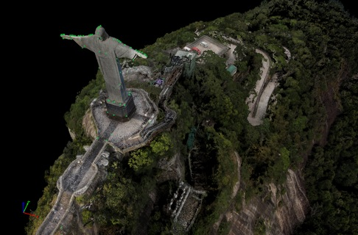
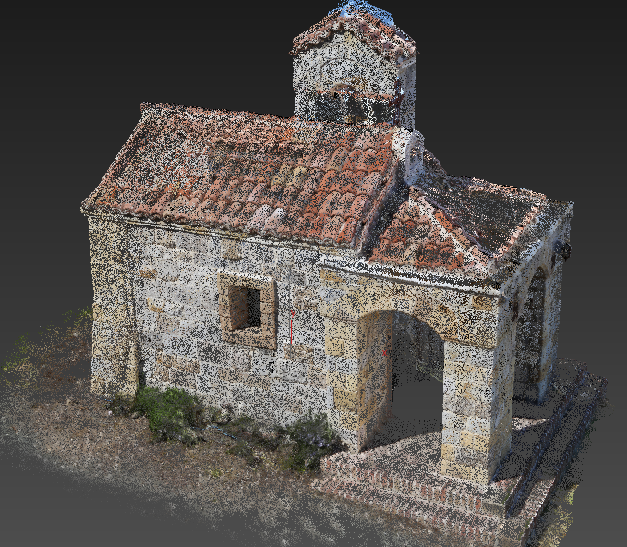
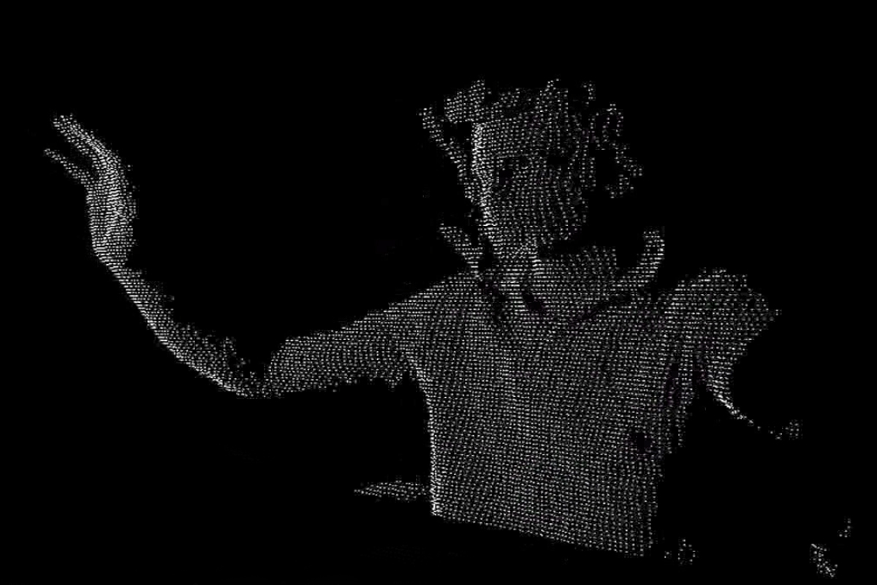
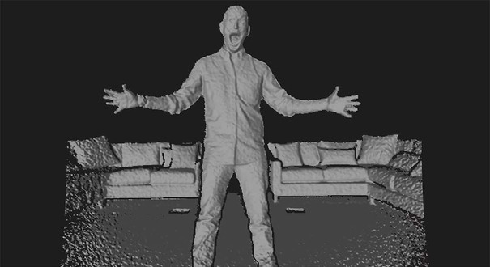
Point Cloud

Slide 32
Point Cloud – AUSILIA example

Slide 33
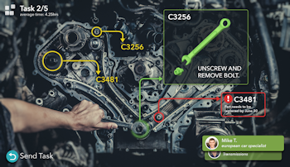
AR Tecnologies
Aims:
Enhance perception of reality through the incorporation of computer generated data and simulations into our senses, creating a reality-based interface
Supplement the real world with virtual objects by overlaying digital imageries and information on top of physical objects and enabling the users of the devices to seamlessly interact with the digital content.
Through the use of computer vision and object recognition, digital information about the real world around us can not only be viewed but also manipulated in real-time
AR enhances and modifies the real world
Tools:
AR Toolkit
Project tango (google)
AR Kit (Apple)
HoloLens

Slide 34
Tracking with markers (AR ToolKit)
This optical tracking method uses a specific pattern of markers placed on an object. One or more cameras then seek the markers, using algorithms to extract the position of the object from the visible markers. The camera detects the markers and their positions leading to the determination of the position and orientation of the object. For example, visible markers can be placed in a specific pattern on the tracking area, and an HMD with cameras would then use this to calculate its position. The shape and size of this type of markers can vary. What is important is that they can be easily identified by the cameras
Tracking markers-less (tango, HoloLens, ARKit)
The Marker-less method uses instead natural features already present in the environment, for tracking purposes. This method is considered more flexible and effective since there isn’t the need for a prepared environment with markers. The decreasing cost of computer vision is another factor that has made marker-less tracking an attractive alternative of tracking. However, this method still has some problems, such as motion blur and fast motion affecting tracking. It also demands a trade-off between precision and efficiency.
AR Technologies diffecencies

Slide 35
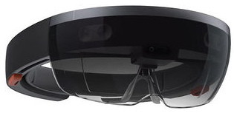
Specs:
Microsoft HoloLens is an Augmented Reality device developed by Microsoft.
It is part of the Windows Mixed Reality AR Platform incorporated with Windows 10 OS.
HoloLens is a see-through HMD display.
Unlike the Oculus Rift and other VR Devices, the eye-piece component of HoloLens is transparent and the headset requires neither PC nor smartphone.
It is able to project high-definition (HD) virtual content or holograms over real world objects.
Uses:
From social apps to games, to navigation, there’s an incredible potential that this mixed reality device can tap into.
Microsoft collaborated with NASA in the making of HoloLens, and there is the potential to control the Mars rover Curiosity via the headset, allowing Nasa staff to work as if they were on the planet themselves.
Microsoft HoloLens

Slide 36
HoloLens components
Microsoft Hololens features:
an inertial measurement unit which includes an accelerometer, gyroscope, and a magnetometer
four grey scale cameras (two on each side)
one depth camera with a 120°×120° angle of view
2.4 megapixel photographic video camera
four-microphone array,
an ambient light sensor

Slide 37
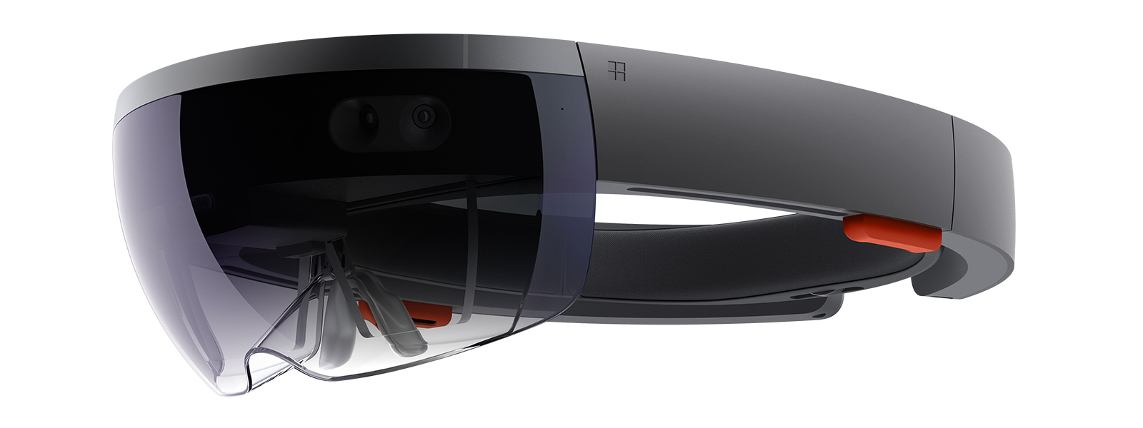
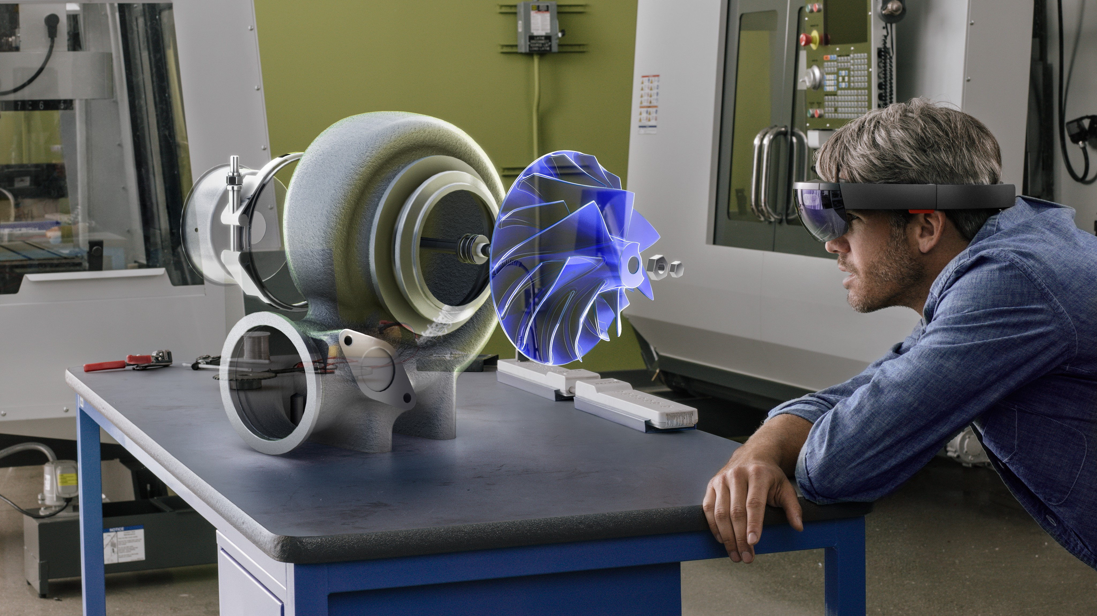
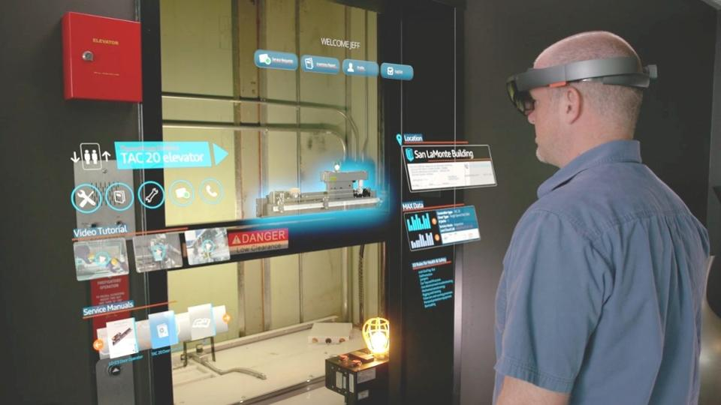
Microsoft HoloLens

Slide 38
In addition to an Intel processor containing the CPU and GPU, HoloLens features a custom-made Holographic Processing Unit (HPU), a coprocessor manufactured specifically for HoloLens by Microsoft.
HoloLens, through the use of the HPU, exploits natural interface commands such as gaze, gesture, and voice.
HoloLens exploits SLAM based on the depth and other cameras in order to estimate the environment map and locate the user view sight with respect to the current viewpoint.

Slide 39
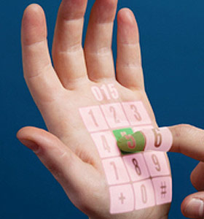
https://www.youtube.com/watch?v=3AADEqLIALk
Microsoft HoloLens

Slide 40
Microsoft HoloLens – robotics application @ UNITN

Slide 41
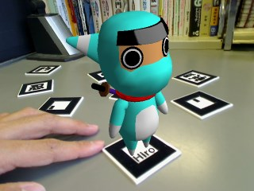
Specs:
ARToolKit 6 is a fast and modern open source tracking and recognition SDK which enables computers to see and understand more in the environment around them. It is being built from the ground up using modern computer vision techniques, up to the minute coding standards and new technologies developed in-house. ARToolKit 6 is being released under a Free and Open Source License that will allow the AR community to use the software in commercial products as well as for research, education and hobbyist development.
Uses:
A simple framework for creating real-time augmented reality applications
A multi platform video library
From games to complex plant, but even inside museum and supermarkets
AR Toolkit

Slide 42
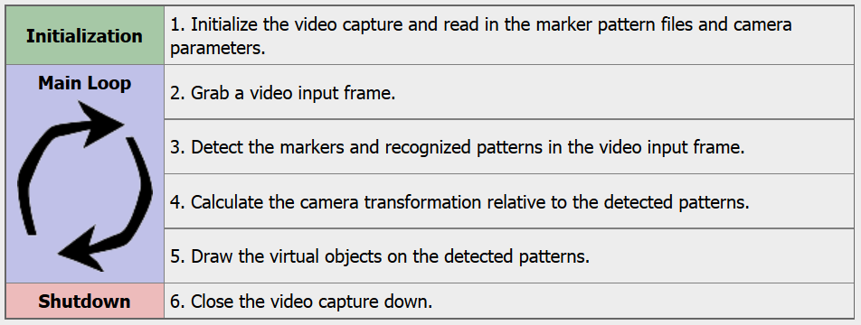
One of the key difficulties in developing Augmented Reality applications is the problem of tracking the users viewpoint. In order to know from what viewpoint to draw the virtual imagery, the application needs to know where the user is looking in the real world. ARToolKit uses computer vision algorithms to solve this problem. The ARToolKit video tracking libraries calculate the real camera position and orientation relative to physical markers in real time. This enables the easy development of a wide range of Augmented Reality applications.
ARToolkit

Slide 43
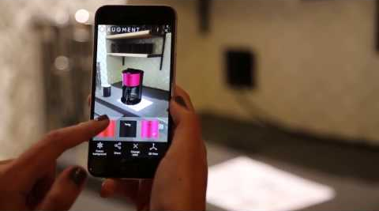
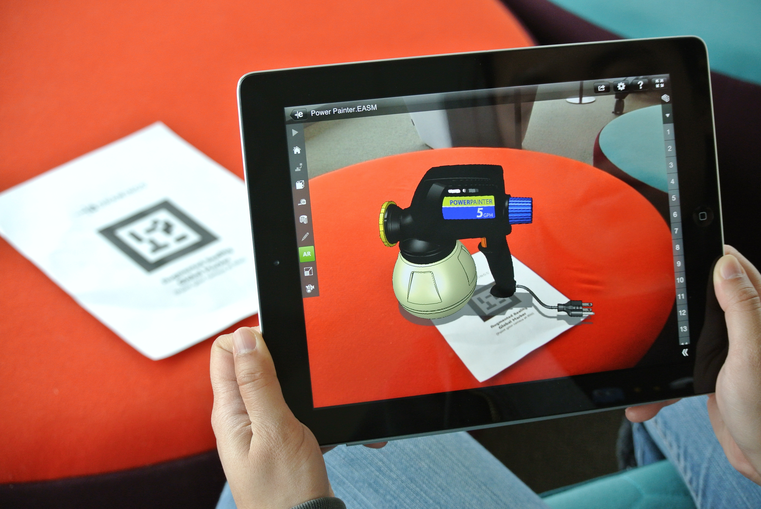
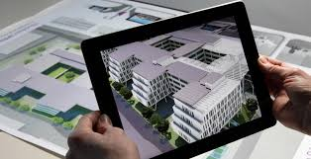
ARToolkit

Slide 44
Specs:
Tango, also known as Project Tango, is a computer vision project developed by Google with a team led by Johnny Lee and Larry Yang. Using various cameras and sensors, Tango mobile devices can map 3D environments in real time and perform marker-less inside-out tracking.
This feature allows the device to become spatially aware and instantly figure out where it is in space.
Project Tango has many potential uses, including incorporation into VR and AR Devices and even Google Cardboard.
Uses:
City-scale mapping (Google Maps)
Rollercoaster experiment
Registration to existing surfaces
Tracking in difficult environments
Real-time 3D room capture
Real-time meshing in Unity with physics
Precise indoor positioning
AR-overlay indoor
Tango / ARKit

Slide 45
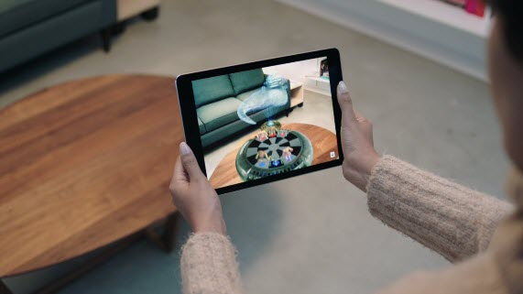
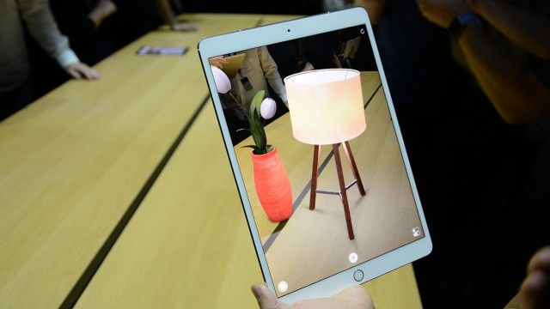
ARKit

Slide 46
small movements
https://www.youtube.com/watch?v=-o7qr1NpeNI
Very extreme test
https://www.youtube.com/watch?v=dMEWp45WAUg
ARKit

Slide 47
Until now we have seen “See-through AR” in which a user have to worn an head-mounted-display (or use a smartphone) through witch they can see real world with computer-generated information superimposed on top
But, there is also another way to do AR projecting computer-generated information directly into user environment:
Spatial AR
Spatial AR models use a unique combination of physical objects and computer-generated information, and hence they inherit advantages from both. There are no widgets to manipulate, no sliders to move, and no displays to look through (or wear). Instead, we walk around objects, moving in and out to zoom, gazing and focusing on interesting components, all at very high visual, spatial, and temporal fidelity.
Spatial AR combine the high level of intuitiveness of physical models with the flexibility and functionality of computer graphics, such as the ability to be quickly altered, animated, saved and updated.
Spatial AR

Slide 48
Spatial AR
In 2D Spatial AR it is needed to sense:
the relative position between a projector and the environment
the environment shape in real time
In 3D Spatial AR it is needed also the user viewpoint in order to adapt the projection as a function of the user eyesight

Slide 49
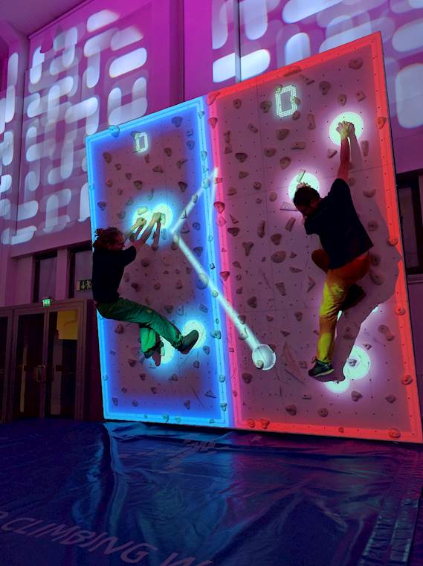
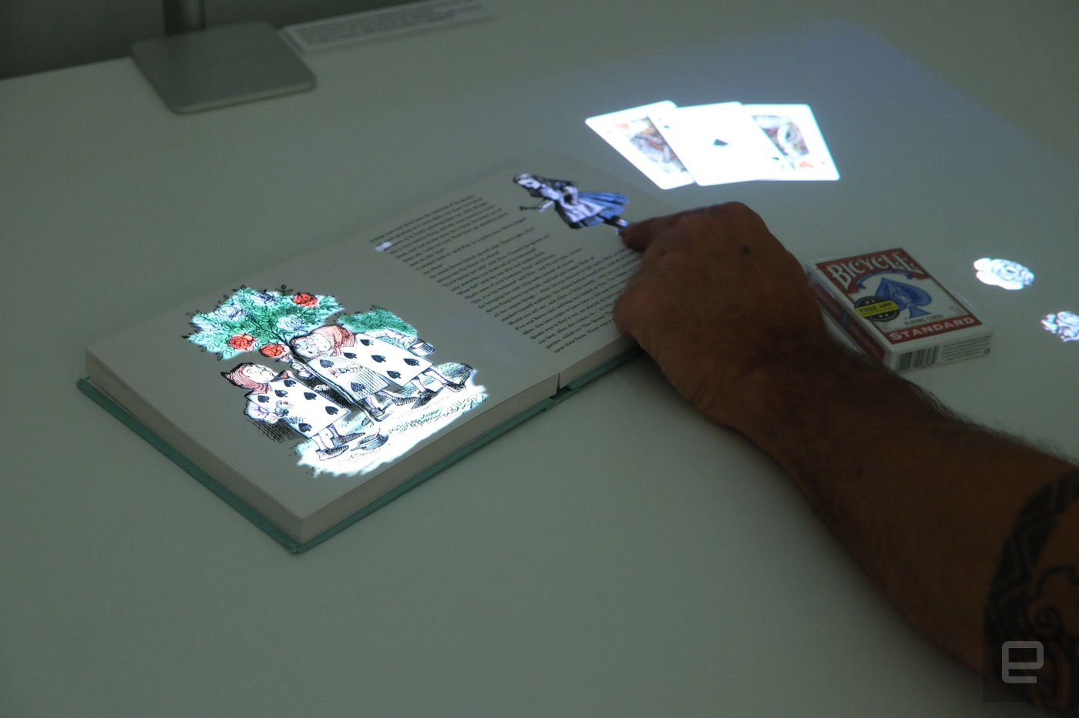
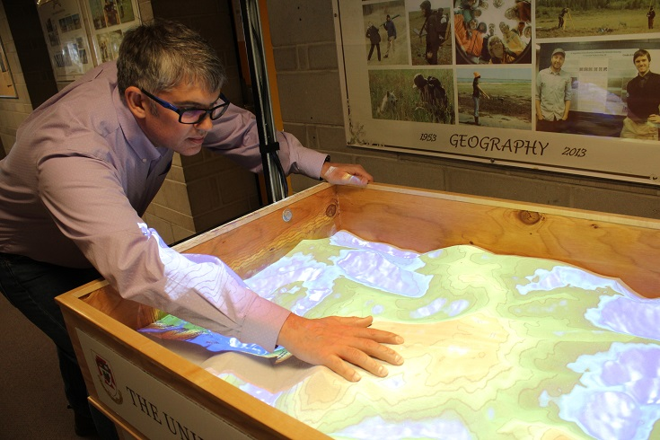
https://lightform.com/
Spatial AR

Slide 50
2017 Course Project on Augmented reality using Kinect and a projector
http://www.miro.ing.unitn.it/index.php/resources/new-media/video/assistive-tabletop-2017
Spatial AR

Slide 51
Taxonomy - EWK

Slide 52
Taxonomy - RF

Slide 53
Taxonomy – EP (Immersiveness)

Slide 54
Taxonomy – some devices

