Slide 1
Some science behind Augmented-Virtual Reality
https://blog.metavision.com/the-natural-machine?utm_campaign=Blog+Conversion&utm_medium=email&_hsenc=p2ANqtz-_FIdCw0KxJY7MItJZALPZHptbPhEmw9xC10W0EBFtjahDc4dqG65vFyp1GWB2ZJBDHxJE8FXld22k8IvR-lyalSxbGUt88OUZu8LDBjOCQya8MvgA&_hsmi=31461956&utm_content=31461956&utm_source=hs_email&hsCtaTracking=c2c9e4cd-f0b9-4371-b703-1d522cae0497%7C3ac84553-0873-42fd-b893-61aedc21f8d3

Slide 2
Science behind Augmented Reality
The “Natural Machine”
“The time has come for devices that keep us in the moment rather than obscuring it. Natural machines, built around the senses we already have, using neuroscience.” - Meron Gribetz, CEO of Meta, at TED 2016
The idea of the natural machine is essentially a system that fits onto a person senses and brain perception like a glove to a hand
It enables people to interact in ways that are totally natural: you see something, grab it, manipulate it, hand it to someone else

Slide 3
Science behind Augmented Reality
But think about how we currently use technology: it’s anything but natural
We use a keyboard, mouse or a trackball to manipulate data and content on a screen, from our tiny phones to large desktop monitors. But no matter how large the screen, size can’t overcome the fundamental flaw…
Our brains just weren’t meant to engage that way. Those technologies create obstacles to connecting rather than facilitating those connections.

Slide 4
Science behind Augmented Reality
Natural machines provide a fully transparent display that reveals the real world alongside digital content in a beautiful blend of the digital and physical worlds.
The person sees both and can engage naturally with digital and physical objects together.

Slide 5
Science behind Augmented Reality
In addition to the headset, the other critical feature of natural computers is that it’s hand-controlled. That’s the “see it, grab it, manipulate it” part.
No input device required, just your hands – the most natural tool for the brain to use.
Natural computing represents a return to the most basic and productive pairing for humans – brain and hand.

Slide 6
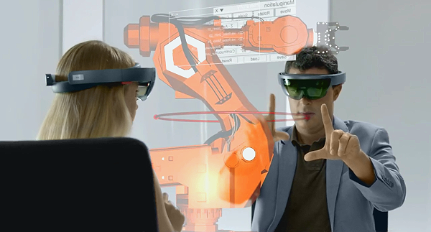
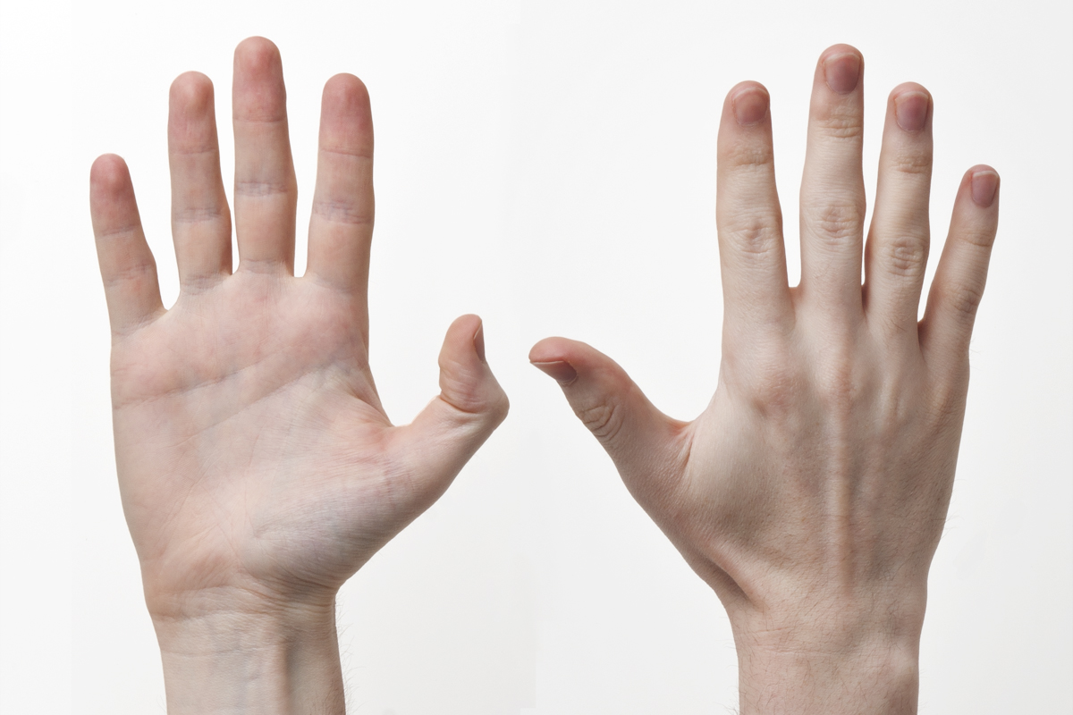
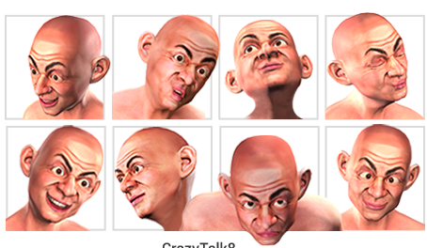
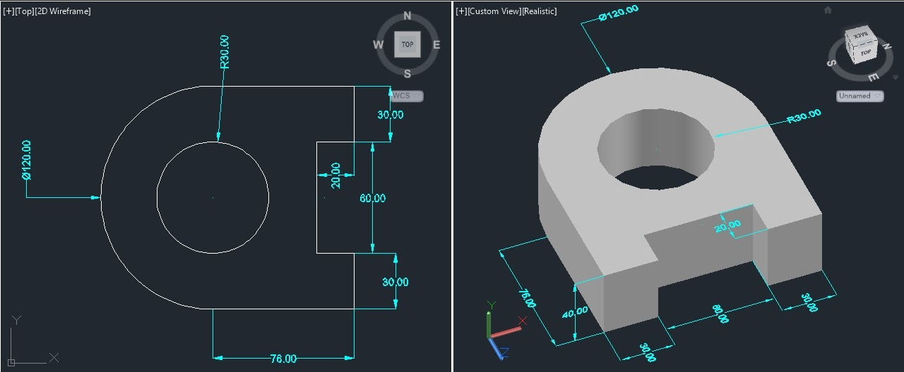
AR
input
perception
Actual
input
perception
An example of manipulating virtual objects..

Slide 7
Science behind Augmented Reality
AR interfaces are unlike any interface from the past. Traditional computers, tablets, and smartphones are flat interfaces acting as portals into our digital worlds or lives. Such devices are isolated objects in our broader physical environments.
With AR, we wear the computer and the computer gives us 3D spatialized information. When we are given the chance to directly interact with this information, we become the interface. We are the operating system (OS)!!!!

Slide 8
Science behind Augmented Reality
This is an implicit revolution in user interfaces that demands a deep understanding of the laws of interaction in the brain and a deep understanding of how the brain interprets sensory and supports motor performance in the three-dimensional space.

Slide 9
Science behind Augmented Reality
In this context, we put together two concepts that overlap only partially: sensation and perception.
By sensation, we mean the way that our senses have to transduce different forms of energy onto neural signal.
By perception, we mean the complex set of operations that our brain does to transform raw sensory input into meaningful information that we interpret and use in our active life.

Slide 10
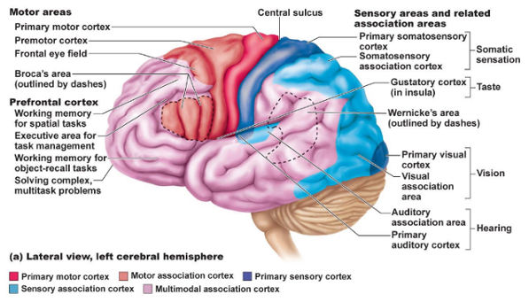
Science behind Augmented Reality
We sense and perceive the world through different channels, but we are by far visual animals. In fact, about one third of the human cerebral cortex is involved in vision. In other words, the neurons in these areas will activate if stimulated with visual information.

Slide 11
Science behind Augmented Reality
Understanding how the brain is engineered to transform visual input into recognition and motor interactions may inspire developers and designers to more deeply embrace our principles of NeuroInterface Design and build AR interfaces that the brain is perfectly equipped for.

Slide 12
Science behind Augmented Reality
The Visual System Performs Feature Segmentation
It first decomposes them in simpler and more decipherable smaller patterns that are then put again together in deeper layers…
The retina, like the sensor of our camera, senses the world with ‘discrete (but specialized) pixels’ called photoreceptors – cones and rods – and transmits information to a deep set of neural layers that reconstruct the building blocks onto meaningful objects and eventually the visual scenery where we live and act.

Slide 13
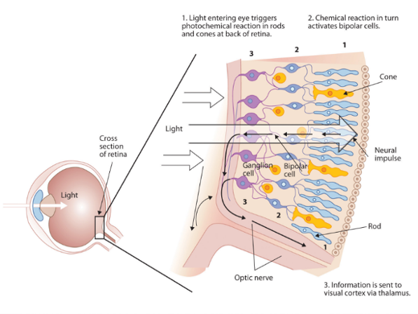
Science behind Augmented Reality

Slide 14
Science behind Augmented Reality
Spatially confined channels in the visual cortex of the brain selectively encode the size of lines and borders, local and global motion pattern, color, stereo disparity, contrast, contour continuity, textural regularities, and so forth…
(Different parts of the visual field have different sensitivity to certain features, e.g., color, contrast, motion).
When this rich set of features gets integrated and fits specific ‘cognitive models’, the visual content achieves recognition and affordance.

Slide 15
Science behind Augmented Reality
3D is in the Brain
If we consider the rays of light that hit our retinae at any given moment, there is no direct information about the three-dimensional structure of the space. We sense the visual world with a pair of 2D sensors: the left and right retinae in the back of our eyes. This flat information is mapped in the early modules of the visual cortex in a way that reflects the slightly different horizontal points of view that the two eyes have on the same object (disparity).

Slide 16
Science behind Augmented Reality
This lateral shift of the image, called "retinal disparity", is interpreted by "binocular" neurons in visual areas of the brain that have different levels of sensitivity to different disparities and form the base of our stereo vision. Objects closer to us will have larger disparities than farther objects, which project in very similar ways in the two eyes.
However, stereo-vision is providing only partial information about the organization of the spatial environment around us, and informs about depth only within a short range.

Slide 17
Science behind Augmented Reality
In order to build a full representation of each object in the environment, the brain requires that the disparity information is integrated with a rich set of image cues that are called pictorial cues to depth.
These cues are called pictorial because they have been typically introduced by Renaissance artists to render a sense of space and depth and they are all monocular (i.e. they work with one eye only). Occlusion is the main cue and is the most powerful of all: closer objects hide farther objects from view.

Slide 18
Science behind Augmented Reality
pictorial cues to depth

Slide 19
Science behind Augmented Reality

Slide 20
Science behind Augmented Reality

Slide 21
Science behind Augmented Reality

Slide 22
Science behind Augmented Reality

Slide 23
Science behind Augmented Reality

Slide 24
Science behind Augmented Reality

Slide 25
Science behind Augmented Reality

Slide 26
Science behind Augmented Reality

Slide 27
Science behind Augmented Reality

Slide 28
Science behind Augmented Reality
In summary .. While pictorial cues seem more abstract and high level than stereo, the brain gives them big credit as it comes to weigh these cues for building space around us.
Prioritizing stereo only and excluding these cues may spoil the design of spatialized UIs!

Slide 29
The Visual System Pays Attention!

Slide 30
Science behind Augmented Reality
The human visual system is usually confronted with many different objects at a time, with only some of them reaching consciousness. Studies revealed two different strategies by which objects are selected for further processing:
an automatic, efficient search process,
a conscious, so-called inefficient search
Have you ever done the following test? If not, you may want to do it by watching the video:
https://www.youtube.com/watch?time_continue=2&v=IGQmdoK_ZfY
https://www.youtube.com/watch?time_continue=93&v=6JONMYxaZ_s

Slide 31
Science behind Augmented Reality
There are studies suggesting that at any given moment, our retinae are hit by 10⁸ bits of information.
By making an analogy with artificial sensors, we can say that the visual system samples at a rate that may vary from 10Hz to just a little under 100Hz (across the system and range of stimuli).
The output of this may go down to a single bit, i.e. a binary decision that sometimes must be taken in a fraction of a second (e.g., based on the visual information available, we may turn right or left, decide to touch button A or button B, etc.)

Slide 32
Science behind Augmented Reality
This sets an incredible compression problem to our visual and cognitive system that evolution solved by enabling us with mechanisms to select relevant information that neuroscientists generally call “attentional” mechanisms. Visual and sensory attention in general makes it possible to select only what is relevant with the task at hand and discarding what is irrelevant – which is the reason why many of you, as well as me the first time I did it, might have missed incredible parts of the scene in the Gorilla test!!!

Slide 33
Top-down attention
Top-down attention is ruled by the mechanisms of visual search, that is by the ability to find individual elements and keep track in cluttered scenes.

Slide 34
Top-down attention
Top-down attention at work: The volleyball player's eyes are focused on the ball coming her way, and is about to leap into action.

Slide 35
Top-down attention
Inattentional Blindness
When people focus on a task that demands their attention, they often fail to notice unexpected objects and events that occur in full view. This phenomenon is known as "inattentional blindness" because people typically do not consciously perceive aspects of their world that fall outside of the focus of their attention.

Slide 36
Bottom-up attention
The second type of visual attention is bottom-up attention.
Example: when you are involved in a generic task and a camera flash shoots, the whole flow breaks and we will automatically orient our attention to the source of the flash.
Indeed, nature equipped us with mechanisms to quickly break the flow and react to sudden stimuli that may represent danger.

Slide 37
Bottom-up attention
The circuitry in the brain that implement these complementary types of information selections are integrated in a way so that the modules that support bottom-up attention act as a circuit breaker for the mechanisms of top-down attention (similar to an interrupt in computer function).
Within a UI, the balance between these two types of attention are under good control of the developer that has to know some basics of neuroscience!!!

Slide 38
Bottom-up attention
Change Blindness
People fail to notice large changes to their visual world when those changes occur during a brief moment of distraction.
Under normal viewing conditions, changes to a scene produce a signal that can grab our attention.
However, when that change signal is hidden by any sort of disruption (a flashed blank screen, an eye movement, a cut from one view to another in a movie), people can and do miss large changes.

Slide 39
What Works Better: 2D or 3D Instructions?

Slide 40
… – 2D or 3D instructions?
What Works Better: 2D or 3D Instructions?
Here META reports a recent study they conducted with Accenture and presented at this year's International Symposium on Mixed and Augmented Reality (ISMAR). They examined whether 3D instructions delivered via AR were more effective than 2D paper / screen instructions. Let’s go on to discover the full results and surprise findings.

Slide 41
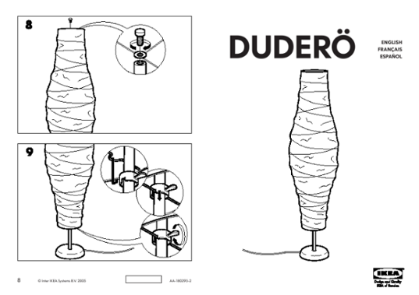
… – 2D or 3D instructions?
Imagine coming home with a new Ikea floor lamp. You open the instruction manual to figure out how the lamp should be assembled.
30 minutes go by and you're on step 9 when you stop because the diagram is mind-boggling:

Slide 42
… – 2D or 3D instructions?
And then you keep needing to go back and forth to look at what you're doing, which wastes time and makes you lose focus.
With augmented reality (AR), you cut that step out and you're able to increase your working memory load by continuously support the user with animations in order to complete the task.
Assembling furniture shouldn't be this difficult, but it usually is because the process comes with subpar paper instruction manuals. And for those of you who think it's not the instruction manuals that are inadequate, but rather people and their inability to follow directions, then we beg to differ with both a short and long answer:

Slide 43
… – 2D or 3D instructions?
The Short Answer
2D instructions – whether they be textual and graphical instructions on a screen or paper – are hard to understand because they're flat representations of complex actions and objects in a 3D environment aka the real world.
This is why simulations/animations (and supervised real-world scenarios) are fundamental for training in highly complex procedural jobs.

Slide 44
… – 2D or 3D instructions?
The Long Answer
From a neuroscience perspective, instructions on paper and screens are cognitively limiting, i.e. difficult to understand, for the following reasons:
1. They're perceptually inefficient
Oversimplified, flat 2D images of 3D objects and actions make it harder for our brains to process and understand the actions that need to be taken.
2. They overload working memory
Like the RAM in computers, working memory is where our brains temporarily store and process information. If our working memories are overloaded, then our performance on complex tasks will be undermined (do you know the law of 7 +- 2 ?).
3. They're difficult to recall
Unless you have "photographic memory", remembering each step to execute in the overall process, along with their corresponding diagrams, is impossible for most people.

Slide 45
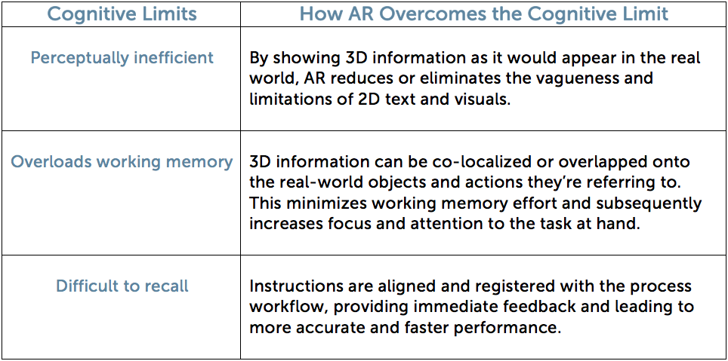
… – 2D or 3D instructions?

Slide 46
… – 2D or 3D instructions?
The current research on AR's (and 3D visualizations) seems to show that static 3D instructions help people execute tasks more efficiently than 2D instructions
At a high level, static 3D visuals introduce the perceptual cue of stereo 3D, which makes it easier for our brain to process and understand the combination of visual and textual information and actions we need to complete the task
From a neuroscience standpoint, the human brain has evolved to become finely attuned to both stereo and motion cues, which indicates why people might find 3D representations of complex tasks easier to understand than 2D representations.

Slide 47
… – 2D or 3D instructions?
Given how our brains work they (META) performed with Accenture a pilot study examining use of perceptual cues in AR.
More specifically, we wanted to measure the effect an additional perceptual cue (motion) would have on the time it takes to complete a procedural task.
We operated under the hypothesis that integrating stereo and motion perceptual cues could reduce limitations of 2D instructions – enabling people to more quickly complete a procedural task.

Slide 48
… – 2D or 3D instructions?
How We Conducted the Study
At this year's Bay to Breakers pre-race expo, the colorful annual footrace in San Francisco (California), we and the Accenture researchers set up the procedural task of assembling a physical lighthouse Lego set. The model (image below) was chosen because it was complex enough to require instructions in order to completely assemble it (several steps called for bricks of various sizes and shapes to be used).

Slide 49
… – 2D or 3D instructions?

Slide 50
… – 2D or 3D instructions?
We defined three conditions based on the different types of instructions participants were to receive:
1. 2D Paper
Copies of each page in the original paper instruction manual were transferred onto a PowerPoint slide and displayed on a computer monitor. We transferred the paper instructions to digital form in order to track participants' time to complete each step. Participants used a keyboard to navigate through the instructions on the screen.
2. Holographic Static 3D (Stereo Cue)
Showed the visual instructions from the same viewpoints as their corresponding 2D paper counterparts. The Lego pieces were made in 3ds Max, a 3D modeling and animation software, and ported into Unity as holographic instructions that mimicked the 2D paper instructions. Participants used the Meta 2 to view the Static 3D Instructions.
3. Holographic Dynamic 3D (Stereo & Motion Cues)
Derived from the same Unity prefabs as the ones used in the Static 3D Instructions, with participants also using the Meta 2 to view the instructions. Showed the same features as the 2D paper counterparts in addition to allowing participants to see the model from all points of view (models were rotated 360° for three seconds at the beginning of each step).

Slide 51
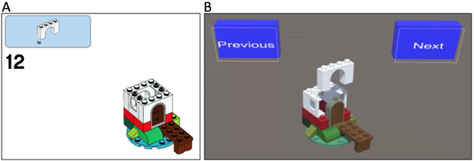
… – 2D or 3D instructions?
2D Paper
Holographic Static 3D
Holographic Dynamic 3D (Stereo & Motion Cues)

Slide 52
… – 2D or 3D instructions?
We drafted 77 voluntary participants, each of whom was randomly assigned to one of the three instruction conditions.
The Results Weren't What We Entirely Expected
Given the time constraints, we were not able to measure participants' accuracy in completing the task. We instead measured the time it took to complete (TTC) each step.

Slide 53
… – 2D or 3D instructions?
Comparing the three instruction conditions, we found that Dynamic 3D Instructions enabled participants to more quickly complete each step. Participants using Static 3D Instructions and 2D Paper Instructions were much slower in comparison. This confirmed our hypothesis that the use of both the stereo and motion perceptual cues in AR instructions speeds up assembly time.
BUT, Interestingly enough, we found that participants using Static 3D Instructions were the slowest of the three instruction conditions.

Slide 54
… – 2D or 3D instructions?
Do These Findings Mean We Should All Use AR Instructions?
This pilot study has shown some promising findings, but by no means is it conclusive. We believe that additional systematic studies of individual perceptual cues are needed, especially with regards to informing AR user interface (UI) design. Our results strongly suggest that careful consideration of AR interface design is needed – we can't just dump applications into 3D and think users will find it easy to use, especially given our study's finding that people performed worse with static 3D instructions than those using paper and dynamic 3D instructions.

Slide 55
Mixed reality best practice to design interfaces
https://medium.com/futurepi/best-practices-for-mixed-reality-design-in-2017-7dab602574eb

Slide 56
Applications of visual perception to virtual reality rendering (SIGGRAPH 2017 Course):
https://www.youtube.com/watch?v=Q7LzilQFuYU

