Slide 1
We have seen an example of application of the theorem, but we are interested in the Bayes' Theorem application to the combine the information and perform the SENSOR FUSION!
Bayes theorem

Slide 2
Consider a state x with continuous values, for example, the distance from a target, and an observation z of this state.
The probability density function for the distribution of the observations of the true value of the state - supposed Gaussian (also called Normal Distribution) - in which the observations are distributed with mean μ and variance σ.
Suppose you have made a z_{p} measurement, you can derive the likelihood function (from the information about the sensor):
Now we want to combine it with the previous information regarding the status:
Bayes theorem - Gaussian scalar case

Slide 3
Bayes theorem can be applied directly to combine this previous information with the sensor information.
And so:
Where:
Bayes theorem - Gaussian scalar case

Slide 4
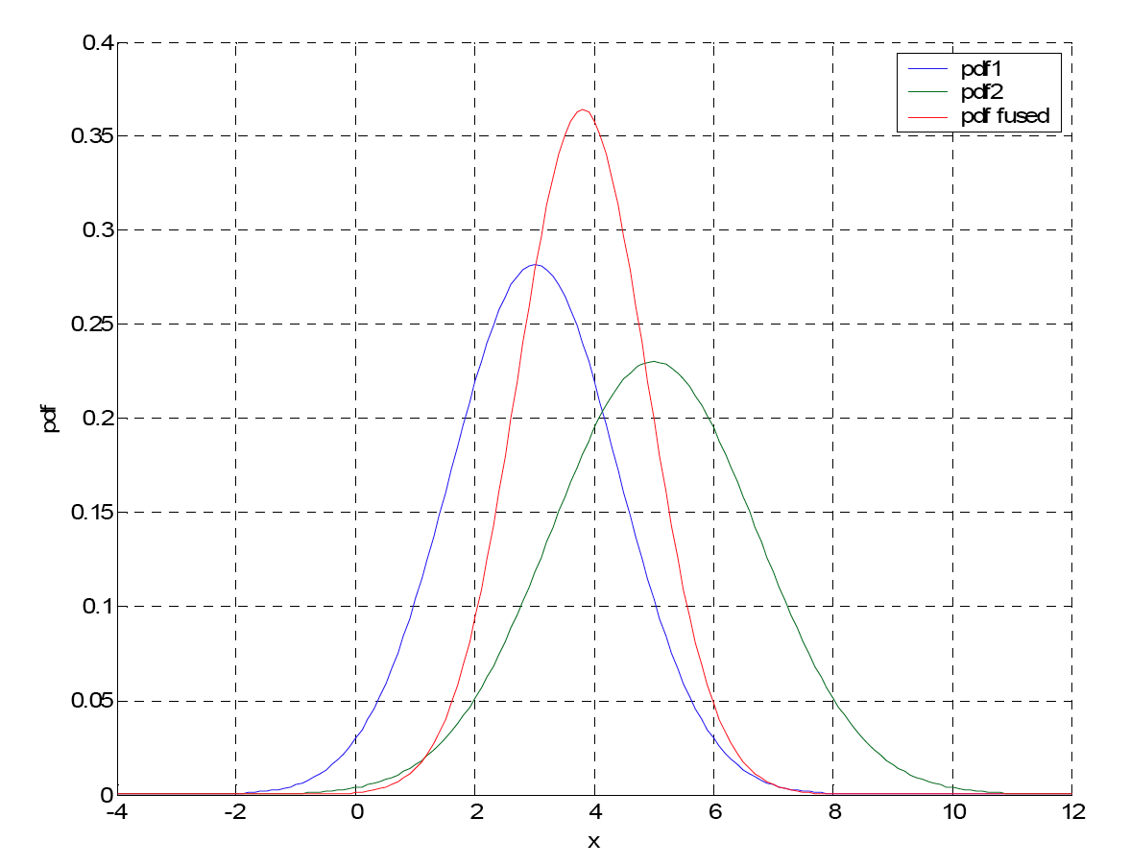
Once the symmetrical property of Gaussian distributions is known (namely that the product of two Gaussian distributions is still a Gaussian distribution with mean and variance expressed by the previous equations) it is not necessary to perform calculations on distributions every time. However, it is sufficient to use already known expressions of the resulting mean and variance.
This result allows the calculation in real-time in a data fusion implementation based on these probabilistic models.
Previous density, likelihood function and posterior distribution.
It is evident that the posterior distribution is still of the Gaussian type, as expected, it is situated in a position interposed between the other two distributions (closer to that with minor variance) and is a narrower bell having a minor variance of the two variances original.
Bayes theorem - Gaussian scalar case

Slide 5
Consider the case where the state x and observation vector z are continuous vectoral variables.
In this case, the variance becomes a matrix (called covariance):
In the hypothesis that the state follows a Normal (Gaussian) probability distribution, the previous distribution P (x) can be represented with a multi-dimensional Gaussian of the type:
where d is the dimension of the vector and x_{p} is the mean value
Bayes theorem - Vectorial Gaussian case

Slide 6
If therefore we hypothesize to carry out an observation z with a sensor having a relative likelihood function represented by the covariance matrix C_{z} (a matrix that represents the repeatability of the sensor):
Finally, it is possible to calculate the posterior distribution P(x|z), in the same way as in the previous example, but taking into account that the distributions are vector values. Therefore the posterior distribution will still be Gaussian, with a covariance matrix equal to the parallel of the starting covariance matrices, namely:
Bayes theorem - Vectorial Gaussian case

Slide 7
The expression of C can also be written more efficiently by calculating a single matrix inversion:
From which:
… perfectly analogous to the scalar case in which it was:
And therefore:
Bayes theorem - Vectorial Gaussian case

Slide 8
While the average of the posterior distribution will be:
… also in this case it is perfectly similar to the scalar version in which it resulted to be :
Bayes theorem - Vectorial Gaussian case

Slide 9
Graphically a two-dimensional Normal distribution is represented by a Gaussian bell whose cross-sections are equiprobability ellipses.
The covariance matrix contains information on the dimensions of the main axes of the ellipses (eigenvalues of the matrix) and their orientation (eigenvectors). An example of the one that graphically corresponds to the equations just obtained is shown in the figure.
Previous density, likelihood function and posterior distribution.
NOTE: the posterior distribution is still Gaussian, it is situated in a position interposed between the other two distributions (closer to the one with a smaller ellipse) and it is a narrower ellipse having a minor covariance matrix.
Bayes theorem - Vectorial Gaussian case

Slide 10
Equi-probability ellipses in the case in which the observation obtained and the relative ellipse of uncertainty always remain the same for 20 observations/measures.
The ellipse of the posterior distribution converges with its center towards the observed value and is being reduced more and more with each iteration.
Bayes theorem - Vectorial Gaussian case

Slide 11
Bayes theorem can be applied directly to the merging of information from different sensors.
What we want to do is get the posterior distribution where the set of observations is defined:
The posterior distribution defines the probability density of the state x data given the information obtained from the n observations.
Bayes theorem - Combination of measures

Slide 12
In practice, it is necessary to know completely the joint and conditional distribution
, namely the joint distribution of all the possible combinations of observations conditioned to the state.
It is generally possible to assume that once the state x is defined, the information obtained from the i-th source of information is independent of the information of the other sources. In other words, the different measuring instruments do not interfere with each other and that therefore the principle applies of conditional independence:
Bayes theorem - Combination of measures

Slide 13
Therefore you get:
Thus, the posterior distribution on x, or the updated probability of the state, is proportional to the product of the previous probability distribution and the probability distributions of each observation.
The marginal distribution of Z^{n} acts as a normalization constant.
This relationship provides a simple method for merging information from multiple sensors and is called an independent probability group
Bayes theorem - Combination of measures

Slide 14
The effectiveness of this method is based on the hypothesis that the observations are independent of each other when conditioned to the true value of the state.
This assumption is reasonable if the state to which the observations refer is the only thing they have in common, therefore once the state has been specified it is reasonable to assume that the information is conditionally independent.
This would certainly not be correct without the conditionality, or it would be wrong to say that the information is unconditionally independent and therefore:
Bayes theorem - Combination of measures

Slide 15
The hypothesis of conditional independence does not necessarily mean that it is always reasonable. For example, if an observation can significantly change the state, this hypothesis is not valid anymore.
An example is represented by the measure with oading effect.
Let us first analyze an example in which the loading effect is absent:
We want to measure the linear position of an axis using two laser instruments (therefore without contact).
The two instruments will provide two conditionally independent measurements since their measurement will depend only on the state of the system and on the accuracy characteristics of each instrument taken individually.
x
Laser 1
Laser 2
Conditional independence - Example

Slide 16
Suppose the measures have normal probability density and zero systematic effect:
Therefore it will result that:
Conditional independence - Example

Slide 17
We represent the joint probability as
If it happens that
As can be intuitively guessed, the maximum probability value occurs with both measurements equal to zero
Conditional independence - Example

Slide 18
We will now analyse an example in which the loading effect is present:
We want to measure the linear position of an axis using a laser instrument and an optical-line feeler that puts the feeler in contact by means of a spring, loading the bracket connected to the slide whose movement must be controlled.
x
Probe optical strip 2 (linear encoder with spring to ensure contact)
Laser 1
The two instruments will provide two conditionally dependent measures since their measurement will depend on whether they are both connected in measurement.
In particular it will be:
(the measure z₁ is related to the laser, z₂ is related to the probe)
Conditional dependence - Example

Slide 19
Suppose the measures have, in addition to the loading effect x_{c}, a normal probability density:
Let's try to evaluate what happens if (wrongly!) we assume conditional independence :
Conditional dependence - Example

Slide 20
We represent the joint (erroneous) probability
In case we have
By looking from above the probability density shows how it now has the maximum value at the value pair [0, 0.5]
This result is wrong as it would mean that the joint event [0, 0.5] has the highest probability of occurring.
We know instead that the maximum must be had for:
It should be in [0.5, 0.5]
z₂
Max in [0, 0.5]
z₁
In fact, we know that if the probe is in contact and the slide is in x=0, the probe will induce a load effect of 0.5, and consequently the laser will measure the value 0.5 with the maximum likelihood.
Conditional independence - Example

Slide 21
We persist in the error and evaluate what happens if we proceed with the combination of the following information:
Let's suppose that we know that the drive travel is limited to [-1 1] and to each value we assign the same level of probability, ie a rectangular probability density function for P(x)
Conditional dependence - Example

Slide 22
Laser
Probe
x
Conditional dependence - Example

Slide 23
The maximum probability value for the state x conditioned to the measures 0.55 and 0.45 is obtained in 0.25 !!!
(It should be 0 instead !!!)
x
Conditional dependence - Example

Slide 24
... let's go back and try to do in the right way !!!
We know that it is necessary to model the conditional joint probability correctly !!!
Let's describe it in words:
if the state assumes a value of x, both measures will assume a maximum probability in x+x_{c} with standard deviation equal to σ_{zi}, and therefore:
The mathematical model results:
Conditional dependence - Example

Slide 25
The maximum probability value for the state x conditional on the measures 0.55 and 0.45 is now 0
The estimated value through the fusion is correct (for this particular case it coincides with the presumed true value of the state)
x
Note: the systematic effect has been compensated
Conditional dependence - Example

Slide 26
The data fusion of several sensors would, in principle, require storing all the past information and, upon the arrival of new k-th information in the form P(z_{k}|x), to recalculate the overall updated probability P(z₁ … z_{k} | x).
But fortunately the Bayes theorem lends itself easily to the recursive implementation:
Bayes
In the event that the conditional independence is valid
Bayes
Bayes theorem - Recursive form

Slide 27
Normalization constant
Fusion at step k
Likelihood function of the new information in step k
Fusion at step k-1
Bayes theorem - Recursive form

Slide 28
In case the probability densities can be modeled by normal distribution, the recursion takes the following form:
Bayesian filtering
where:
Recursive form - Gaussian case

